Slide 1
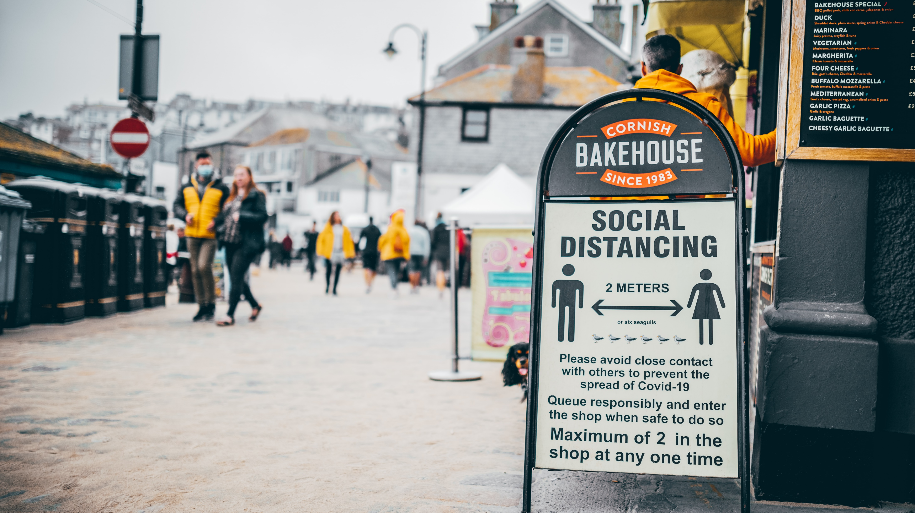
Did stringency measures influence Happiness across the world over the course of the pandemic?

Slide 2
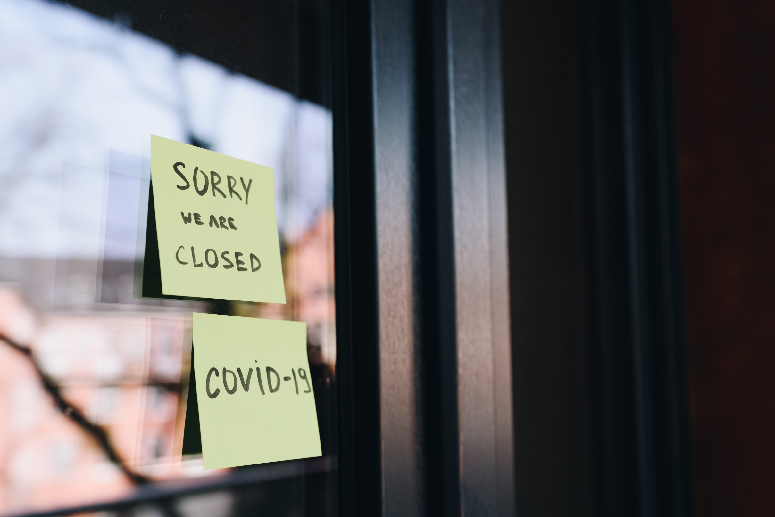
Did stringency measures influence Happiness across the world over the course of the pandemic?

Slide 3

Did stringency measures influence Happiness across the world over the course of the pandemic?

Slide 4

Did stringency measures influence Happiness across the world over the course of the pandemic?

Slide 5

Did stringency measures influence Happiness across the world over the course of the pandemic?

Slide 6

Did stringency measures influence Happiness across the world over the course of the pandemic?

Slide 7

Did stringency measures influence Happiness across the world over the course of the pandemic?

Slide 8
